Slide 1









GOLD SPONSORS
SILVER SPONSORS
BRONZE SPONSOR
STRATEGIC PARTNER

Slide 2
Azure SQL Database yesterday, today and tomorrow
Marcin Szeliga
Hubert Kobierzewski

Slide 3


Marcin Szeliga
Data philosopher
20 years of experience with SQL Server
Data Platform MVP & MCT
Microsoft Certified Solutions Expert
Data Management and Analytics
Cloud Platform and Infrastructure
Business Intelligence
Microsoft Certified Solutions Developer
Azure Solution Architect

Slide 4

Hubert K. Kobierzewski
BI Practice Lead in Codec (over 10 years)
Specialized in: Data Warehousing, ETL processes and Business Intelligence
Ex-Developer
MS SQL Server certified (MCDBA, MCTS, MCITP, MCSE – BI, MCT)
Member of Azure Advisors (internal MS group)
Leader of Warsaw Data Community Chapter
Leader of Warsaw Power BI User Group

Slide 5
Agenda
Service overview
Intelligence
Scalability
Elastic pools
BC + DR
Compatibility
Security
Migration

Slide 6
The Azure Data Platform – Operational data
Operational
Analytical
Streaming
SQL Database
SQL Data Warehouse
Stream Analytics
Tables
Data Lake Analytics/Store
Blobs
HBase
Hive/Spark/…
Storm/Spark Streaming/Kafka
Cosmos DB
Machine Learning
Event Hubs
Data Factory
IoT Hub

Slide 7
SQL Database - A relational data service
SQL
Database
Relational Data
Application
Send SQL query
Return rows and columns

Slide 8
Data platform continuum
On-premises
Hybrid cloud
Off-premises
Shared lower cost
Platform as a service
Software as a service
Infrastructure as a service
Azure SQL Database
Managed Instance / Virtualized Databases
Virtual
SQL Server in Azure VM
Virtualized Machines
Physical
SQL Server Private Cloud
Virtualized Machines + Appliances
SQL Server
Physical Machines (raw iron)
Dedicated higher cost
Higher administration
Lower administration

Slide 9
Azure SQL Database
The developer’s intelligent cloud database service
Learn and adapt with your app!
Scales on the fly without app downtime!
Build multitenant apps with customer isolation and efficiency!
Work within your environment
so you can focus on building great apps!
Protects and secures
your app data!

Slide 10
DEMO
Creating database

Slide 11
Intelligent capabilities
Built-in performance monitoring with intelligent advisors helps reduce troubleshooting time
The Azure management portal exposes real-time metrics and dashboard, and you can set check and alerts on database performance
Azure SQL Database includes intelligent advisors:
Index Advisor
Query Performance Insight
Threat Detection
Query Store
Elastic DB Advisor
Graph Support
Adaptive Query Processing
More…

Slide 12
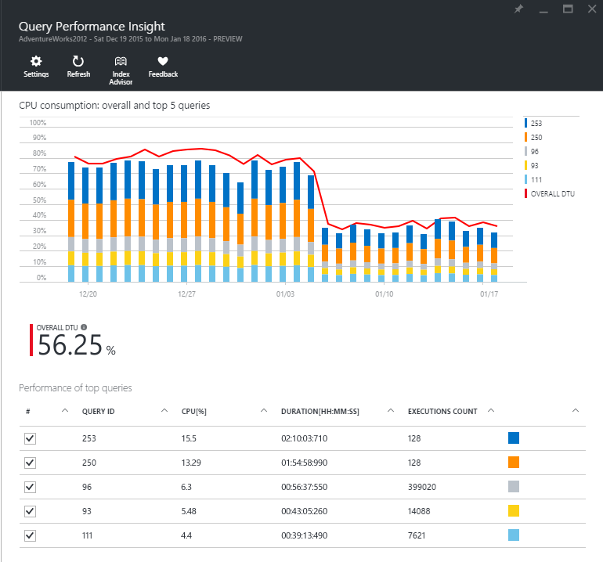
Query Performance Insight
See how database resources are being consumed
See the most CPU-intensive queries:
Customize your view by selecting observation interval, number of queries, and aggregation type
View aggregated statistics about your workload: total duration and number of executions
Drill down to a specific query:
Get granular view on query execution intervals
View query text

Slide 13
Query Performance Insight
Workload Insight feature in Azure SQL Database that helps customers understand and tune the performance of their databases by providing:
Insights into resource consumption
Query Performance Insights shows resource (DTU) consumption of top resource-consuming queries over time, and helps pinpoint the potential issues with additional details for each query
Hints for optimization
* Query Performance Insights gives tuning hints for top resource consumers
Query Performance Insights can help users with the following:
Answer the question “Where are my DTUs spent?” and understand the impact of their top queries on the resource consumption of the database over time
Identify the queries to fix, before (or after) they become a problem
*future experiences + integration with other WI advisors

Slide 14
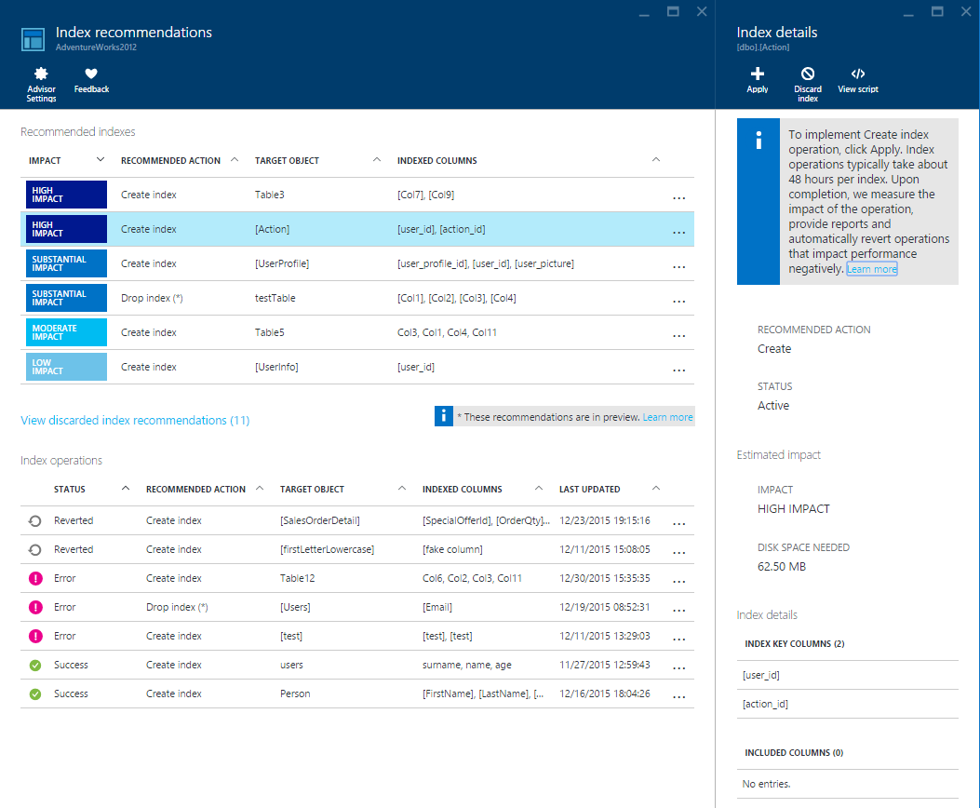
SQL Database Advisor
Improve the database performance with index tuning recommendations
Index tuning recommendations tailored to each DB
Recommendations are based on the observed usage, and evolve as the DB workload changes
Support for CREATE and DROP index, more types of recommendations underway
Intelligent service for implementing and validating index recommendations
Full-auto mode: service takes full care of the indexes for your DB
Manual “review and apply” mode for full control
Report + visualization of index impact
Tuning Models
SQL Database
Index Advisor
Azure Cloud

Slide 15
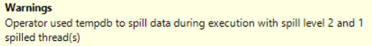
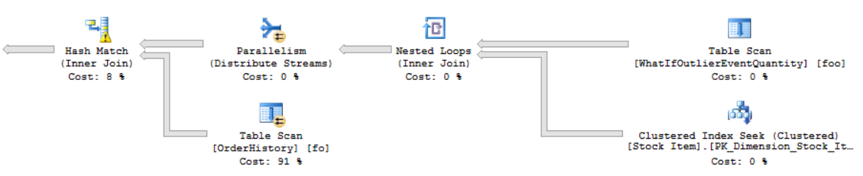
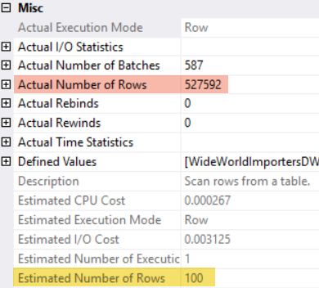
Cardinality Estimation and Plan Quality

Slide 16
Potential impact of misestimation…
Slow query response time due to bad plans
Excessive resource utilization (CPU, Memory, IO)
Reduced throughput and concurrency
T-SQL refactoring for off-model statements

Slide 17
Adaptive Query Processing Feature Family
Interleaved Execution
Materialize estimates for multi-statement table valued functions (MSTVFs)
Downstream operations will benefit from the corrected MSTVF cardinality estimate
Batch-Mode Memory Grant Feedback
Adjust memory grants based on execution feedback
Remove spills and improve concurrency for repeating queries
Defer the choice of hash join or nested loop until after the first join input has been scanned
Uses Nested Loop for small inputs, Hash Joins for large inputs
Batch-Mode Adaptive Joins

Slide 18
Determine your service tier
 | Basic | Standard
 | B | S0 | S1 | S2 | S3 | S4 | S6 | S7 | S9 | S12
DTUs | 5 | 10 | 20 | 50 | 100 | 200 | 400 | 800 | 1600 | 3000
Max database size (GB) | 2 | 250 | 250 | 250 | 1000 | 1000 | 1000 | 1000 | 1000 | 1000
Max in-memory OLTP storage (GB) | N/A | N/A | N/A | N/A | N/A | N/A | N/A | N/A | N/A | N/A
Max concurrent workers | 30 | 60 | 90 | 120 | 200 | 400 | 800 | 1600 | 3200 | 6000
Max concurrent sessions | 300 | 600 | 900 | 1200 | 2400 | 4800 | 9600 | 19200 | 30000
Point-in-time restore period (days) | 7 | 35
Disaster Recovery | Active Geo-Replication, up to 4 readable secondary backups
 | Premium
 | P1 | P2 | P4 | P6 | P11 | P15
DTUs | 125 | 250 | 500 | 1000 | 1750 | 4000
Max database size (GB) | 1000 | 1000 | 1000 | 1000 | 4000 | 4000
Max in-memory OLTP storage (GB) | 1 | 2 | 4 | 8 | 14 | 32
Max concurrent workers | 200 | 400 | 800 | 1600 | 2400 | 6400
Max concurrent sessions | 30000
Point-in-time restore period (days) | 35
Disaster Recovery | Active Geo-Replication, up to 4 readable secondary backups
The Basic, Standard, and Premium service tiers offer differing feature sets, so the first step in selecting an appropriate tier is to determine the service tier that provides the minimum level of feature capabilities required for your application and business.

Slide 19
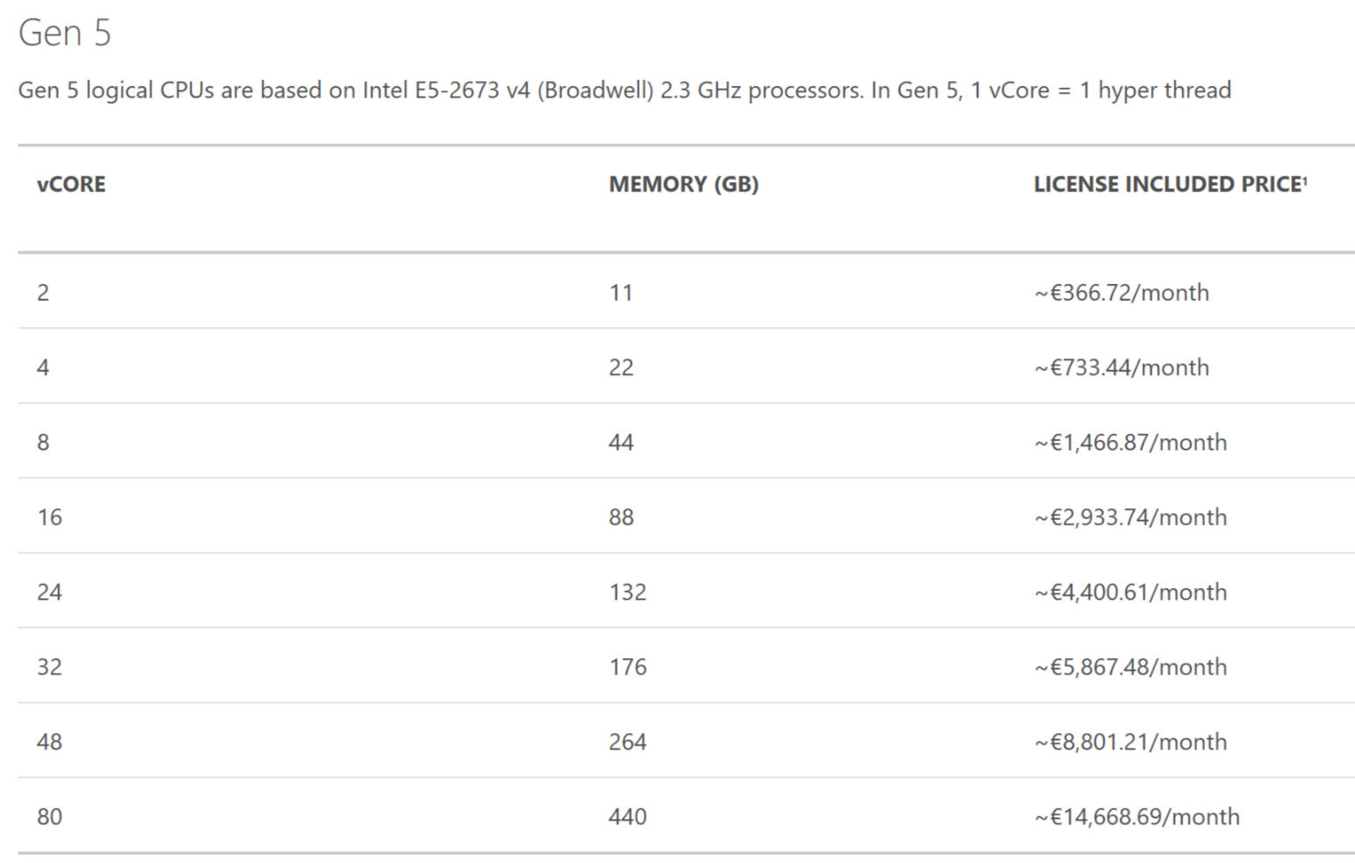
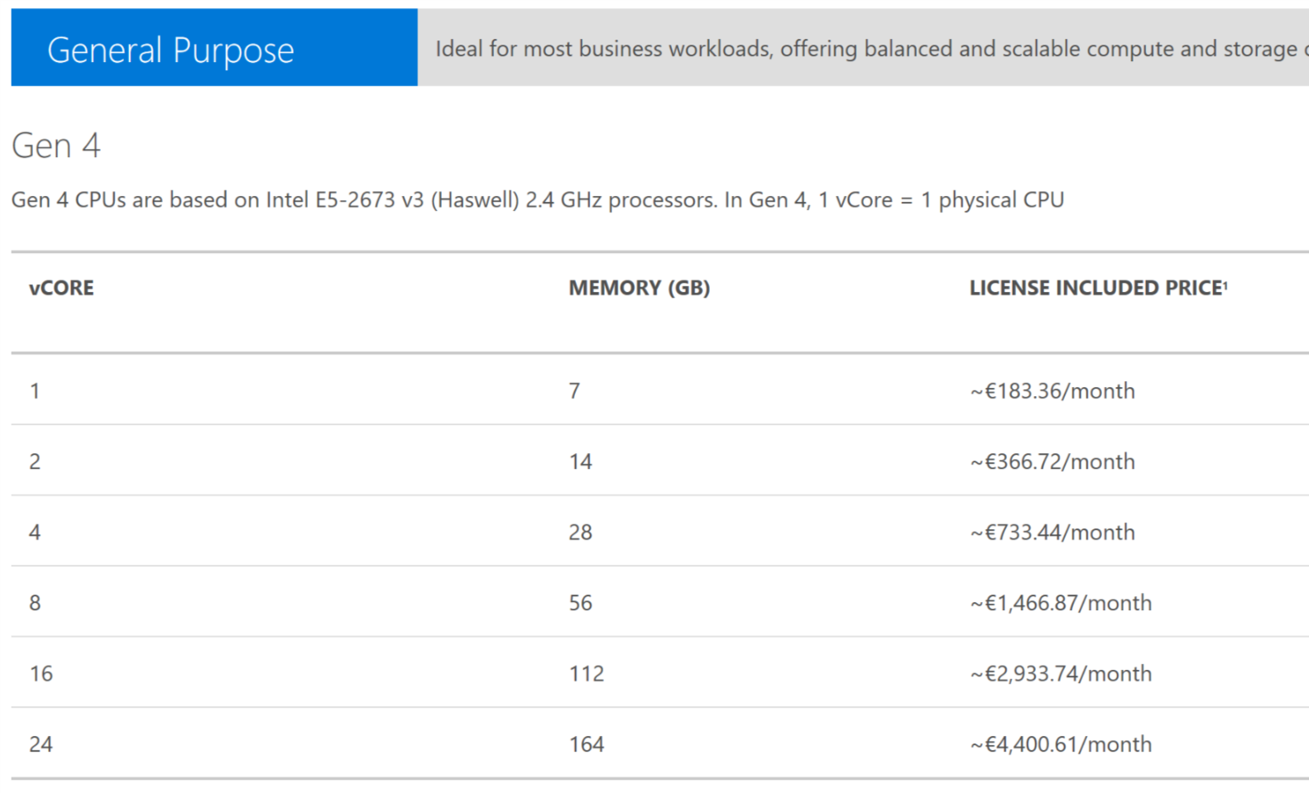
Determine your service tier

Slide 20
Database Transaction Unit – DTU
Bounding box
Monitoring database workload utilization within bounding box
CPU
30%
Represents the relative power (resources) assigned to the database
Blended measure of CPU, memory, and read-write rates
Compare the power across performance levels
Simplifies talking about performance, think IOPS vs. %
75%
Writes
Reads
Utilization
50%
60%
Memory

Slide 21
Upgrade to new service tier/performance level
Azure Management Portal | On your database dashboard page, click the Pricing tier tab
Azure PowerShell | Use the Set-AzureSqlDatabase cmdlet
Service Management REST API | Use the Update Database command
Transact-SQL | Use the ALTER DATABASE (Transact-SQL) statement
After you determine the appropriate service tier and performance level for your web or business database, you can choose from multiple ways to upgrade the database to the new tier.

Slide 22
DEMO
Scaling up and down with no downtime

Slide 23
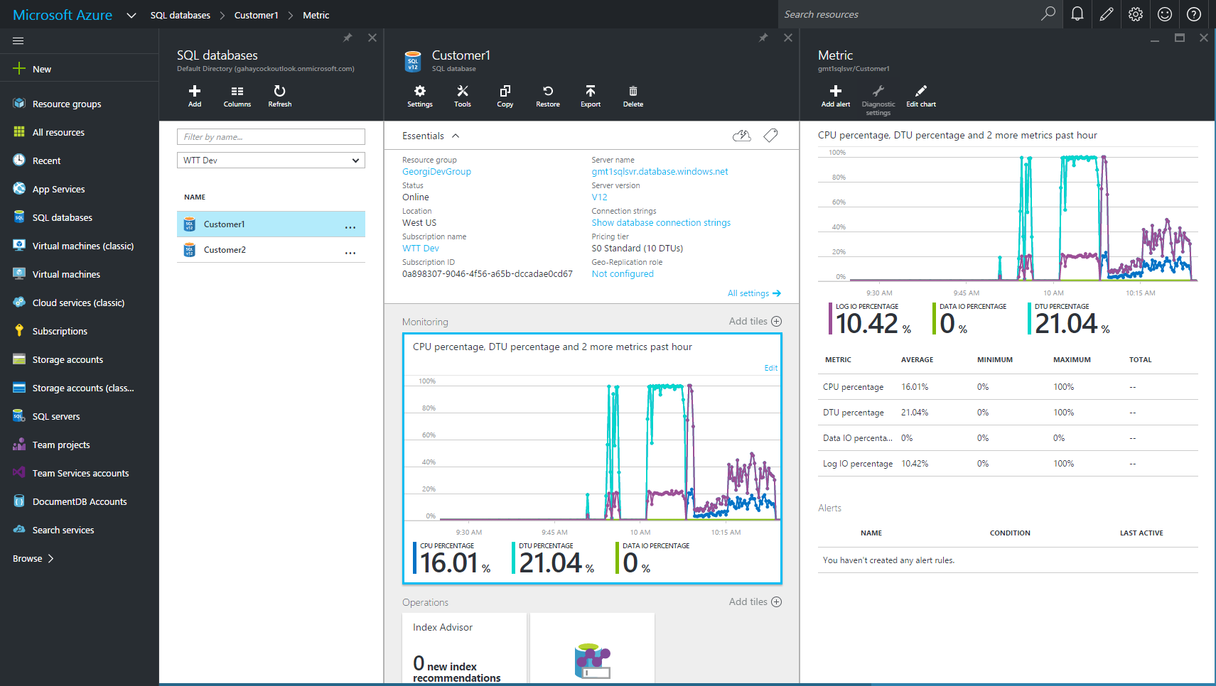
Resource monitoring
master.sys.resource_stats
Based on 5 minute averages
userdb.sys.dm_db_resource_stats
Based on 15 second averages
Percentages relative to performance level
Accessible though Azure Portal
Enables configuration of alerting

Slide 24
What is difficult about building SaaS?
A SaaS model requires supporting a large number of customers
Managing many customers and databases is hard
How can you deal with isolation versus packing lots of customers into a database?
What are your resource needs and economic/business considerations?
How can you future proof for scale?
How can you handle changing business models?
One architectural pattern for SaaS applications is to create one database per end customer
Purchasing individual databases and overprovisioning to meet the variable and peak demand for each database is often not cost-efficient

Slide 25
Software as a service (SaaS)
Apps
Catalog
Central directory (catalog) that stores customer profiles
One database per end customer (tenant)
Often for security and isolation
Some rely on schema customization
Data-dependent routing is a common data-access path
Highly selective key-lookup queries, multi-joins, and more
Mid to low data-entry rate
No need for cross-customer (fan-out) queries
Most tenants are small and “cold,” and some might have hot spots
Optimizing cost of goods solid (COGS) by picking the right service tier for the customer (mostly Basic)
Example
MYOB, Sage
Cust 1
Cust 2
Cust 3
Cust N

Slide 26
Database workload patterns
Resources
Resources
Resources
2017
Mon
Tue
Wed
Thu
Fri
Sat
2015
2016
Sun
9:00
9:15
9:30
9:45
10:00
Time
Time
Time
Characteristics
Predictable, stable
Fluctuating, predictable
Unpredictable, occasional use
On-premise
Difficult: need to predict the future
Expensive: need to provision for peaks
Expensive: need to provision for peaks
SQL DB
Cost-efficient: scale up resources as you need them
Cost-optimizable: scale the resources as needed
Expensive: need to provision for peaks

Slide 27
Cost-effective resource pooling for SaaS workloads
Hourly
share resources
Daily
Weekly
9:00
9:15
9:30
9:45
10:00
0:00
12:00
2017
2015
2016
23:59
Mon
Tue
Wed
Thu
Fri
Sat
Sun
Yearly
Individually unpredictable
Collectively stable and predictable
Expensive, must provision each db for peaks
Cost effective, scale pool up/down based on trends

Slide 28
Elastic database model
Elastic databases in elastic database pools
Pooled resources are used by many databases
Standard elastic database pools provide 50-3000 database throughput units (DTUs) for up to 500 databases
Elastic Standard databases can burst up to 100 DTUs (S3 level)
Create/configure pools using portal, Azure PowerShell, REST APIs
Move databases in/out using portal, Azure PowerShell, REST APIs, and T-SQL
Databases remain online throughout
Monitoring and alerting available on both pools and databases
Max per-database burst level
DTUs
200
400
800
1,200

Slide 29
Elastic database pools and tools
Manage and monitor multitenant apps with the isolation benefits of one customer per database
Free yourself from the administration overhead of designing, buying, building, and managing each customer’s environment
Elastic database pools
Elastic jobs
Elastic transaction
Elastic query

Slide 30
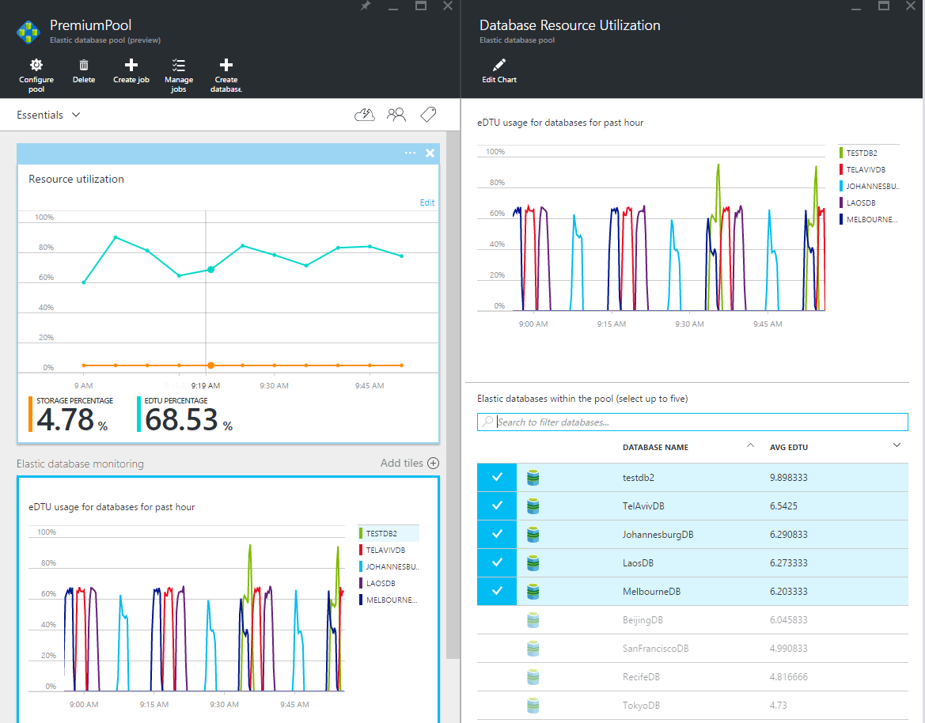
Monitor and Manage Elastic Pools

Slide 31
Querying across many databases
Elastic database query
Connect to a single Azure SQL Database instance using familiar Azure SQL Database connection strings
Simple setup with Transact-SQL Data Definition Language (DDL)
Transparently query many databases from a single database
Familiar programming experience with Transact-SQL, ADO. NET Linq, Entity Framework (EF), and others
Use familiar development and business-intelligence (BI) tools to query across many databases
Designed for interactive querying

Slide 32
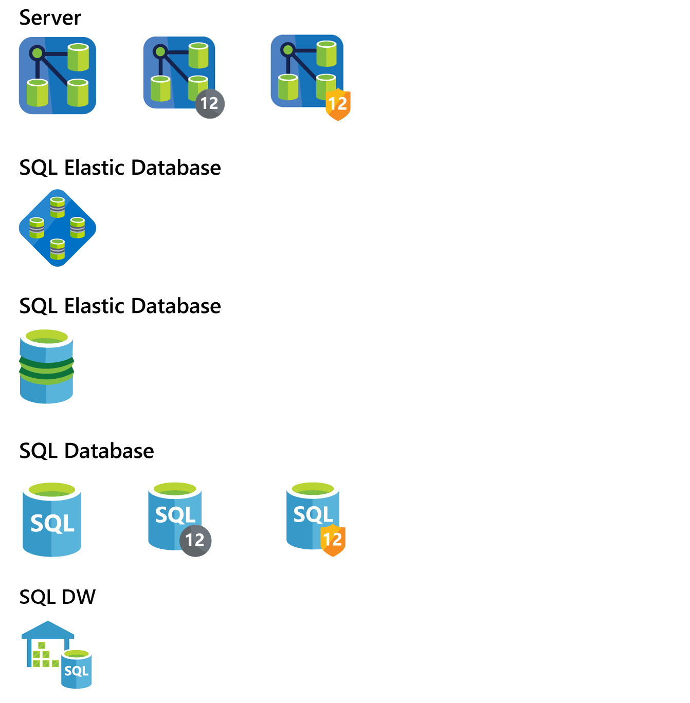
Azure SQL DB Elastic Database service tiers
 |  | BASIC | STANDARD | PREMIUM | PREMIUM RS
Elastic Database Pools
 | eDTU range | 50-1600 | 50-3000 | 125-4000 | 125-1000
 | Max. storage per pool (GB) | 5-156 | 50-2.9 TB | 1-750 | 250-750
 | Max in-memory OLTP storage per pool (GB) | N/A | N/A | 1-32 | 1-10
 | Max. databases per pool | 10-500 | 100-500 | 50-100 | 50-100
 | Elastic database DTUs (eDTU) | ~$1.5 / eDTU per month | ~$2.25 / eDTU per month | ~$5.58 / eDTU per month | ~$1.40 / eDTU per month (preview pricing)
Elastic Databases
 | eDTU max per database | 5 | 50-100 | 125-4000 | 125-1000
 | Storage max per database | Up to 250 GB

Slide 33
DEMO
Elastic DB Pools

Slide 34

Point-in-time restore
Automatic backup
Full backups weekly, different backup daily, log backups every 5 minutes
Daily and weekly backups automatically uploaded to geo-redundant Azure Storage
Self-service restore
Point-in-time up to a second granularity
REST API, PowerShell, or Portal
Creates a new database in the same logical server
Tiered retention policy
Basic - 7 days Standard - 35 days Premium, Premium RS - 35 days
No additional cost to retain backups
SQL Database backups
Azure Storage
sabcp01bl21
Geo- replicated
sabcp01bl21
Restore from backup

Slide 35
Long-term data retention
Export a database
Live database
Generate a BACPAC in external storage and hydrate as needed
Utilize lower performance tier SQL database to support quick data retrieval

Slide 36
Geo-restore protects from disaster
Built-in disaster recovery capability available for every database
Self-service restore API
Restores last daily backup
No extra cost, no capacity guarantee
RTO>=24h, RPO=24h
Database URL will change after restore
SQL Database Backups
Geo-redundant
Azure Storage
sabcp01bl21
sabcp01bl21
Restore to any Azure region

Slide 37
BCDR scenarios in service tiers
SCENARIOS
Basic
Standard
Premium
Premium RS
Local failures | ✓ | ✓ | ✓ | ✓
Azure Database service maintenance | ✓ | ✓ | ✓ | ✓
Accidental data modifications | ✓ | ✓ | ✓ | ✓
Regional disaster | ✓ | ✓ | ✓ | ✓
Disaster recovery drill | ✓ | ✓ | ✓ | ✓
Online application upgrade | ✓ | ✓ | ✓ | ✓
Online application relocation | ✓ | ✓ | ✓ | ✓
Load balancing | ✓ | ✓ | ✓ | ✓

Slide 38
DEMO
Business Continuity / Disaster Recovery

Slide 39
Near-complete SQL compat; more performance
Broader SQL Server support for improved compatibility on Azure
Online index rebuild capability for clustered and non-clustered indices for greater availability
Build highly optimized schemas to improve query processing with table partitioning support
Access Common Language Runtime (CLR) and define CLR types, aggregates, functions, and procedures written in C#
In-memory columnstore index for data marts
Support for additional Dynamic Management Views (DMVs) for deeper insight into application health

Slide 40
Flexibility to work your way
Your Azure solution
Build secure apps that connect with the languages and platforms you prefer
Platforms
Windows, Linux, and Apple
Tools
Azure Management Portal with HTML5 support, Windows PowerShell, REST APIs, SQL Server Management Studio, and Visual Studio
Languages
C#, Java, Ruby, PHP, Node.js, and Python
Frameworks
Entity, Hibernate ORM, Ruby on Rails, and Django

Slide 41
Layers of protection
Azure Active Directory
Encryption
Data protection
Row-Level Security
Auditing and threat detection
Stringent regulatory compliance
Centrally manage and control identity and user access
Encrypt a database, associated backups, and log files at rest—without changing your app
Protect data at rest, in motion, or in use with encryption that uses the National Institute of Standards and Technology (NIST) Advanced Encryption Standard 256 cipher
Control which users can access specific row-level data and how much specific data they can see
Get notified of potential threats with auditing tools and anomalous activity alerting
Leverage ISO/IEC 27001/27002, Fed RAMP/FISMA, SOC, HIPPA, and PCI DSS compliance

Slide 42

Azure Active Directory authentication
Manage user identities in one location.
Use Azure Active Directory user identities and groups to enable access to Azure SQL Database and other Microsoft services.
Benefits include:
Alternative to SQL Server authentication
Limits proliferation of user identities across databases
Allows password rotation in a single place
Enables management of database permissions by using external Azure Active Directory groups
Elimination of the need to store passwords
Customer 1
Customer 2
Customer 3
Azure SQL Database
For more information click Trust Architecture

Slide 43
Azure SQL Database encryption: overview
Encryption type | Type | Customer value
Encryption-in-transit | Transport Layer Security (TLS) from the client to the server | Protects data between client and server against snooping and man-in-the-middle attacks. Azure SQL Database is phasing out Secure Sockets Layer (SSL) 3.0 and TLS 1.0 in favor of TLS 1.2.
Encryption-at-rest | Transparent Data Encryption (TDE) for Azure SQL Database | Protects data on the disk. Key management is done by Azure, which makes it easier to obtain compliance.
Encryption-end-to-end | Always Encrypted for client-side column encryption | Data is protected end-to-end, but the application is aware of encrypted columns. This is used in the absence of data masking and TDE for compliance-related scenarios.
In-transit
At-rest
End-to-end
Customer data
Database files, backups, Tx log, TempDB

Slide 44
Transparent Data Encryption
All customer data encrypted at rest
Encrypted at rest, in flight, and while in use
SQL Database service manages your keys
Keep application changes to a minimum
Encryption/decryption of data done transparently in TCE-enabled client driver
Support for equality operations (include joins) on encrypted data
Azure manages encryption keys
SQL Database

Slide 45
Always Encrypted
Encrypted sensitive data and its corresponding keys are never seen in plaintext in SQL Server
Trusted – Client
Untrusted – SQL Server
"SELECT Name FROM Customers WHERE SSN = @SSN",
"111-22-3333"
ADO.NET
"SELECT Name FROM Customers WHERE SSN = @SSN",
0x7ff654ae6d
ciphertext
Result set
Result set
Name
Jim Gray
Name
0x19ca706fbd9a
dbo.Customers
ciphertext
Name | SSN | Country
0x19ca706fbd9a | 0x7ff654ae6d | USA

Slide 46
Row Level Security
One Policy manager creates filter predicate and security policy in T-SQL, binding the predicate to the Patients table
Two App user (e.g., nurse) selects from Patients table
Three Security Policy transparently rewrites query to apply filter predicate
Nurse
Database
Policy Manager
Security
Policy
Filter Predicate:
INNER JOIN…
Application
Patients
CREATE FUNCTION dbo.fn_securitypredicate(@wing int)
RETURNS TABLE WITH SCHEMABINDING AS
return SELECT 1 as [fn_securitypredicate_result] FROM
StaffDuties d INNER JOIN Employees e
ON (d.EmpId = e.EmpId)
WHERE e.UserSID = SUSER_SID() AND @wing = d.Wing;
CREATE SECURITY POLICY dbo.SecPol
ADD FILTER PREDICATE dbo.fn_securitypredicate(Wing) ON Patients
WITH (STATE = ON)
SELECT * FROM Patients
SEMIJOIN APPLY dbo.fn_securitypredicate(patients.Wing);
SELECT * FROM Patients
SELECT Patients.* FROM Patients,
StaffDuties d INNER JOIN Employees e ON (d.EmpId = e.EmpId)
WHERE e.UserSID = SUSER_SID() AND Patients.wing = d.Wing;

Slide 47
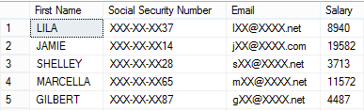
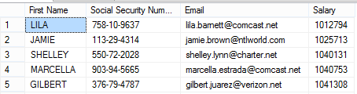
Dynamic data masking
Security officer defines dynamic data masking policy in T-SQL over sensitive data in the Employee table
3) The dynamic data masking policy obfuscates the sensitive data in the query results
2) The app user selects from the Employee table
SELECT Patients.* FROM Patients,
StaffDuties d INNER JOIN Employees e ON (d.EmpId = e.EmpId)
WHERE e.UserSID = SUSER_SID() AND Patients.wing = d.Wing;
ALTER TABLE [Employee] ALTER COLUMN [SocialSecurityNumber]
ADD MASKED WITH (FUNCTION = ‘SSN()’
ALTER TABLE [Employee] ALTER COLUMN [Email]
ADD MASKED WITH (FUNCTION = ‘EMAIL()’)
ALTER TABLE [Employee] ALTER COLUMN [Salary]
ADD MASKED WITH (FUNCTION = ‘RANDOM(1,20000)’)
GRANT UNMASK to admin1
Security
Officer
other logon
admin1 logon
SELECT [Name],
[SocialSecurityNumber],
[Email],
[Salary]
FROM [Employee]
SELECT * FROM patients
SEMIJOIN APPLY dbo.fn_securitypredicate(patients.Wing);

Slide 48
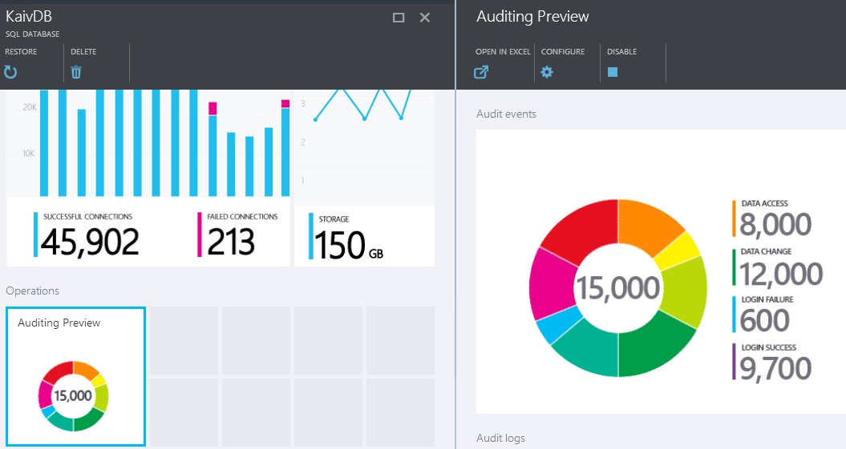




Auditing
Gain insight into database events and streamline compliance-related tasks
Configurable to track and log database activity
Dashboard views in portal for at-a-glance insights
Pre-defined Power View reports for deep visual analysis on audit log data
Audit logs reside in your Azure Storage account
Available in Basic, Standard, and Premium
Access via Azure portal
Audit
log
Azure Storage
SQL
Database
Auditing
Application data

Slide 49


Threat detection
Detects anomalous database activities that could indicate potential threat
Configure threat detection policy in Azure Portal
Receive alerts from multiple database-threat detectors that identify anomalous activities
Explore audit log around the time of an event
External attacker
Azure SQL Database
Threat
Detection
Web app
Malicious insider
ALERTS
Alert

Slide 50
DEMO
Security

Slide 51
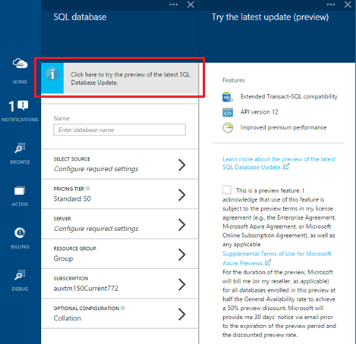
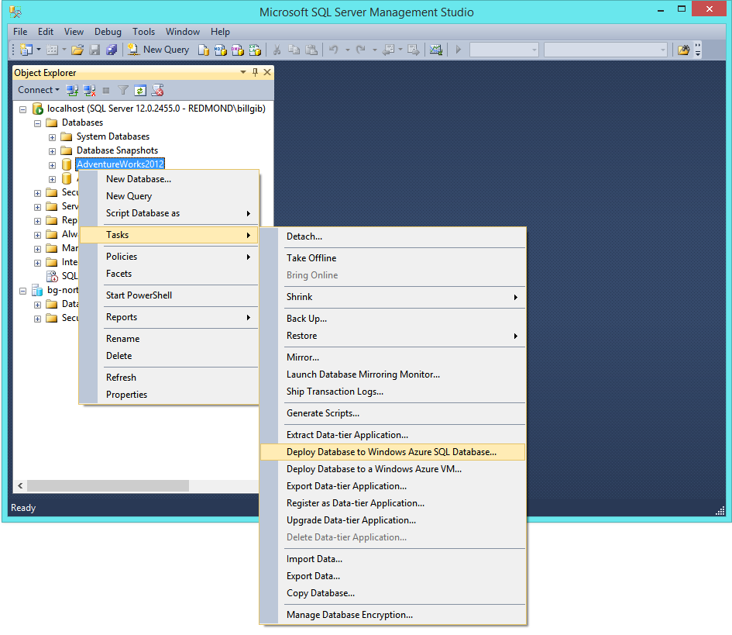
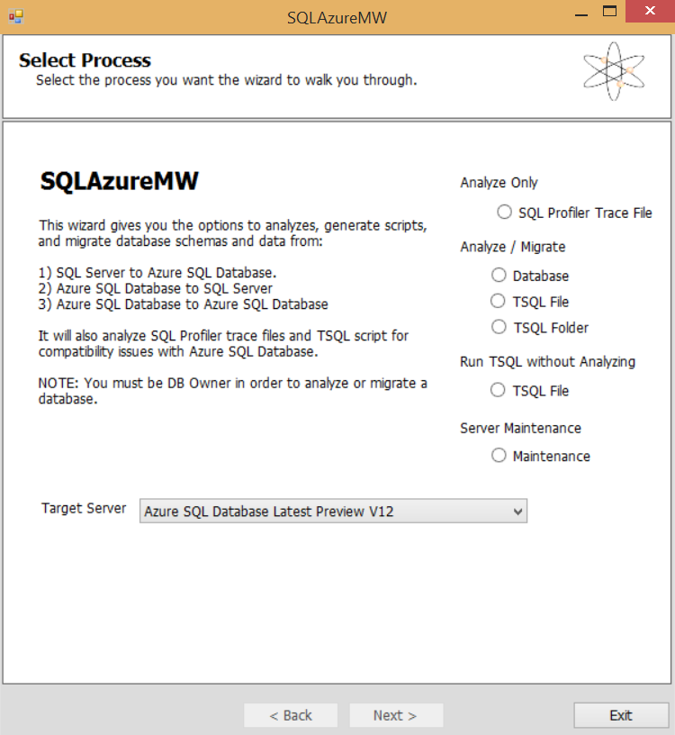
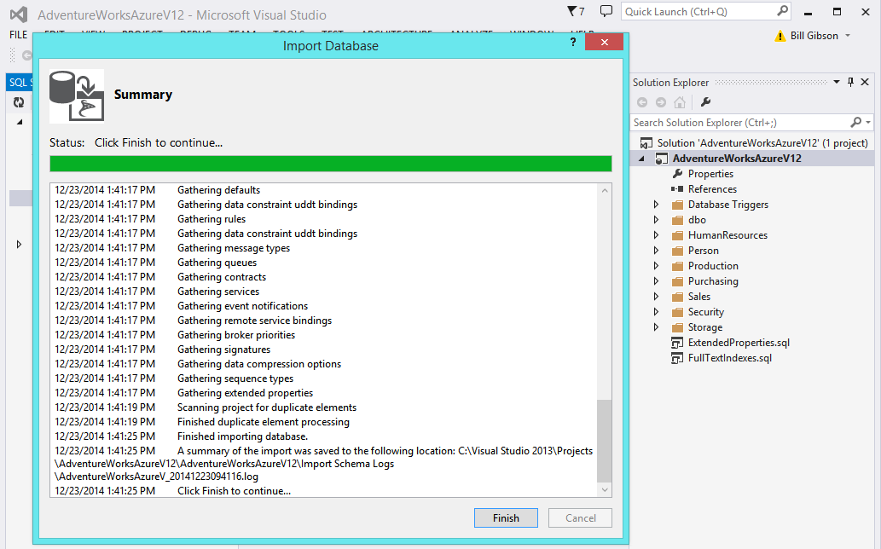
Migration tools
Azure Management Portal
SQL Server Management Studio (SSMS)
SQL Azure Migration Wizard (SAMW)
SQL Server Data Tools in Visual Studio
Data Migration Assistant

Slide 52

Migration methodologies
Method 1
Method 2
Method 3
SQL Server
SQL Server
SQL Server
Source DB
Source DB
Source DB
1. Import
Visual Studio
Database Project
1. Export
1. Generate
4. Copy
2. Transform
SSMS
OR
1. Deploy
SQL Azure Migration Wizard
Copy DB
5. Publish
*.sql
SQL
Azure
Migration
Wizard
SSMS
.bacpac
T-SQL
2. Import
2. Execute
6. Export/ Import or Deploy
3. Edit, Build & Test
Target DB
Target DB
Target DB
4. Publish (schema only)
Azure SQL Database
Azure SQL Database
Azure SQL Database
Migrate a compatible database using SSMS
Migrate a near-compatible database using SAMW
Update the database schema offline using Visual Studio and SAMW, and then deploy it with SSMS

Slide 53
Why use SQL Database?
Intelligent service
Supports multiple database technologies
Features for specific scenarios
Monitors performance and makes automatic adjustments and recommendations
Detects and warns about threats, e.g., attempts to access sensitive data
More
SQL Server
MySQL
PostgreSQL
For SaaS ISVs: Built in support for multi-tenancy with Elastic Pools
For lift and shift: Access to full managed SQL Server in the cloud with Managed Instance

Slide 54


Azure SQL Database yesterday, today and tomorrow
marcin.szeliga@datacommunity.pl
https://www.linkedin.com/in/marcinszeliga
hubert.kobierzewski@datacommunity.pl
https://www.linkedin.com/in/kobierzewski

